Slide 1
CHAPTER 4
DIFFERENTIAL EQUATIONS

Slide 2
CONTENTS
4.1. Modeling with Differential Equations
4.2. Direction Fields & Euler's Method
4.3. Separable Equations
4.4. Exponential Growth and Decay
4.5. The Logistic Equation
4.6. Predator-Prey Systems

Slide 3
4.1. MODELING WITH DIFFERENTIAL EQUATIONS
4.1.1 Models of Population Growth
4.1.2 A Model for the Motion of a Spring
4.1.3 General Differential Equations

Slide 4
A mathematical model is a description of a real world phenomenon to understand it and predict about its future behavior
The Mathematical model often takes the form of a differential equation that contains an unknown functions and some of its derivatives
The reason is that in a real world problem, changes occur and we want to predict future behavior on the basis of how current values change

Slide 5
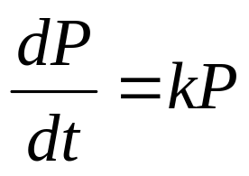
4.1.1 Models of Population Growth
To get a model for the growth of a population we assume that it grows at a rate proportional to its size
Let the independent variable be t (time) and the dependent variable be P (number of individuals of the population), then we have the differential equation
(1)
where k is the proportionality constant

Slide 6
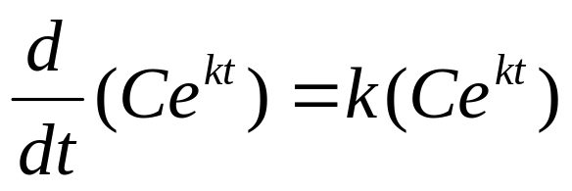
Some Conclusions:
If P(t) > 0 and k > 0 then P'(t) > 0 for all t , i.e. the population is always increasing
Furthermore the growth rate increases as the population increases
To find a solution we remember that the class of exponential functions satisfies the same property on growth rate, namely

Slide 7
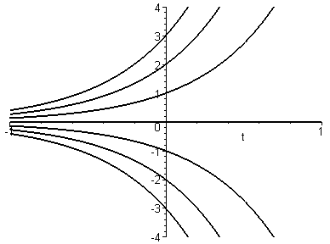
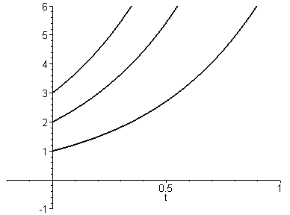
So P(t)=Ce^{kt} is a solution, and we will prove later that (1) has no other solution
Following are the graphs of the solutions P(t)=Ce^{kt} for some values of C
However only C > 0 and t ≥ 0 give rise to meaningful solutions

Slide 8
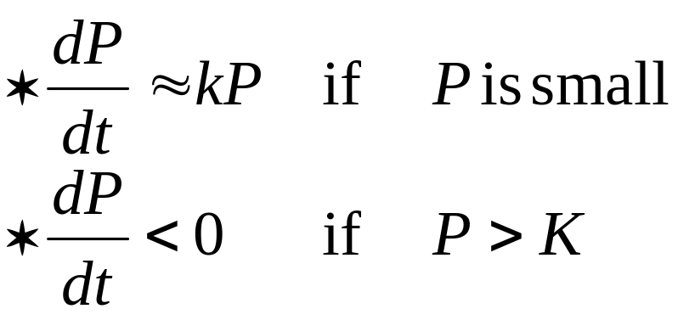
Equation (1) is only appropriate for ideal conditions.
To get a more realistic model we must reflect the fact that a given environment has limited resources. Many populations start by growing in an exponential manner, then the population levels off when its size approaches its carrying capacity K (or decreases toward K if it exceeds K)
Therefore we have to make the following assumptions:

Slide 9
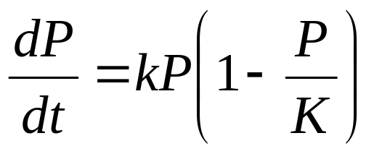
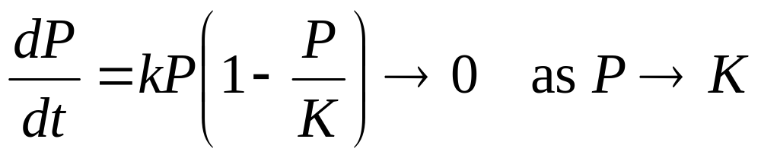
The following logistic differential equation incorporates both assumptions:
(2)
Note that the constant functions P(t) = 0 and P(t) = K are solutions of (2) : the equilibrium solutions
If 0 < P(0) < K then the population increases, but if P(0) > K then the population decreases.
In either case, the population levels off when its size approaches its carrying capacity K because

Slide 10
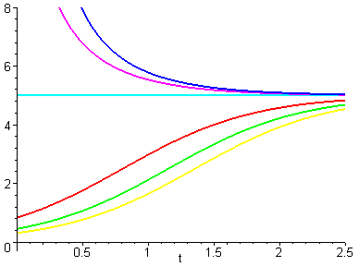
Note that the graphs move away from the equilibrium solution P = 0 and move toward the equilibrium solution P = K

Slide 11
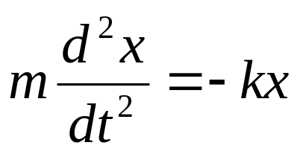
4.1.2. A Model for the Motion of a Spring
Consider the motion of an object with mass m at the end of a vertical spring.
Hooke's law stated that :
restoring force = - kx
where the spring constant k is positive
If we ignore all external resisting force, the Newton's second Law gives
x
F

Slide 12
(3)
This is a second order differential equation. It says that the second derivative of x is proportional to x but has opposite sign.
This remind us the familiar property of the functions sine and cosine.
In fact it can be proved that all solutions are combinations of certain sine and cosine functions: this reflects the fact that the spring oscillates about its equilibrium position

Slide 13
4.1.3 General Differential Equations
A differential equation is an equation that contains an unknown function and one or more of its derivatives. The order of a differential equation is the order of the highest derivatives that occurs in the equation
In general the independent variable doesn't have to represent time. For example the independent variable in the following equation is x
(4) y' = xy

Slide 14
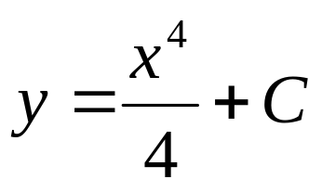
A function f is called a solution of a differential equation if the equation is satisfied when we substitute y=f(x) and its derivatives into the equation.
Thus f is a solution of (4) if
f'(x) = x f(x)
for all values of x in some interval
When we solve a differential equation, we have to find all solutions (the general solution) of the equation
For example the general solution of
y' = x³
is

Slide 15
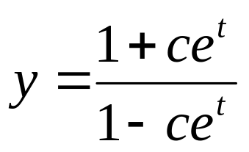
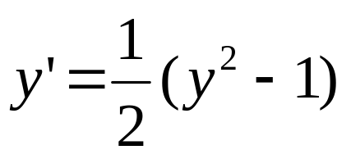
In general solving a differential equation is not an easy matter
Example: show that the functions
are the solutions of the differential equation
(5)

Slide 16
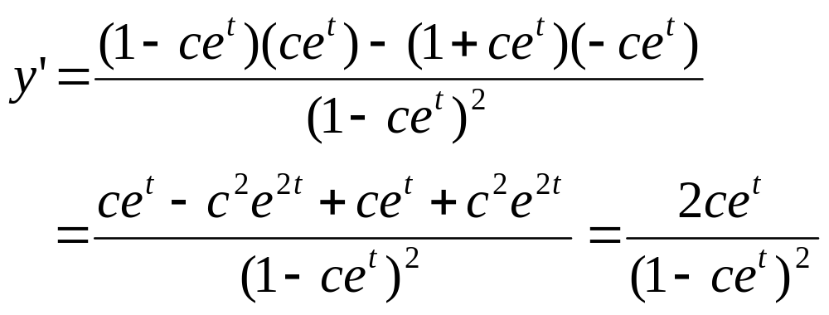
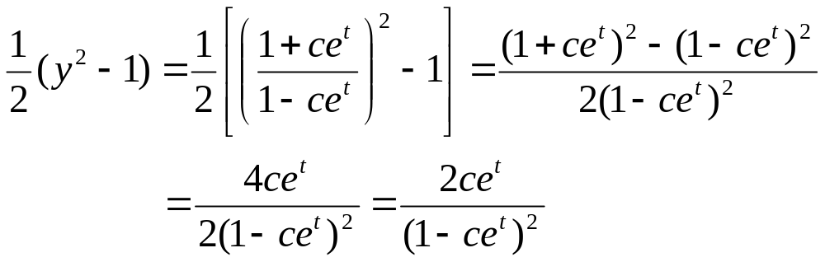
Solution: apply the Quotion Rule to the left hand side
The right hand side of the equation is equal to
QED

Slide 17
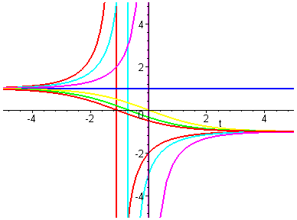
Note that the graphs are flatten near y = 1 and y = -1 because the differential equation shows that y’ ≈ 0

Slide 18
In application we are not as interested in finding the general solution of a differential equation as we are in finding a solution that satisfies some additional requirement, such as the initial condition of the form y(x₀) = y₀. This is an initial-value problem
Geometrically, we are selecting among the solution curves, the one that pass through the point (x₀, y₀)
Physically, this corresponds to measuring the state of the system at time t₀ and using the solution to the initial-value problem to predict about the future behavior of the system

Slide 19
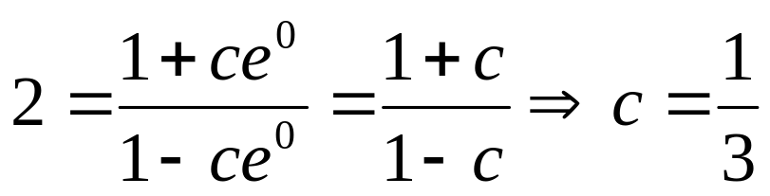
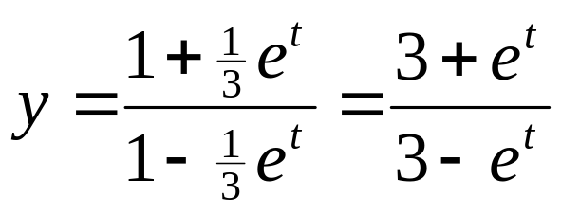
Example: find a solution of the differential equation (5) that satisfies the initial condition y(0) = 2
Solution: substituting the values t = 0 and y = 2 into the general solution we get
So the solution of the initial-value problem is

